Slide 1
NEURODIDACTIC
ASPECTS OF STRESS AND TRAUMA

Slide 3
Difficulty Focusing: Trauma can lead to problems with attention and memory. Students may seem "spacey", forgetful, or have a hard time staying on task.
Emotional Dysregulation: Traumatized children may have difficulty managing their emotions. They might have intense reactions to small problems, have sudden mood swings, or seem unusually irritable or anxious. This can be disruptive and confusing in a classroom context.
Social Problems: Trauma can impact a child's ability to form and maintain healthy relationships. They might be socially withdrawn, overly clingy, or have a hard time understanding social cues.
Behavioral Issues: Children dealing with trauma might act out in class, be defiant, or exhibit aggressive behaviors. Alternatively, they may seem overly compliant and withdrawn.
Learning Difficulties: Due to issues with focus, memory, and emotional regulation, trauma can lead to academic struggles, making it harder for a student to keep up with their peers.
Effects of Trauma on Classroom Behavior:
Trauma can have significant impacts on a student's behavior in the classroom. This is because traumatic experiences can affect a child's ability to self-regulate, leading to difficulty concentrating, and may cause hyperarousal or hypervigilance, all of which can manifest as behavioral issues in an educational setting.

Slide 4
Safe environment
Supportive relationships
Opportunities to succeed
Self-regulation and coregulation
Naming feelings and situations to calm the child
Self-respect and self-esteem

Slide 5
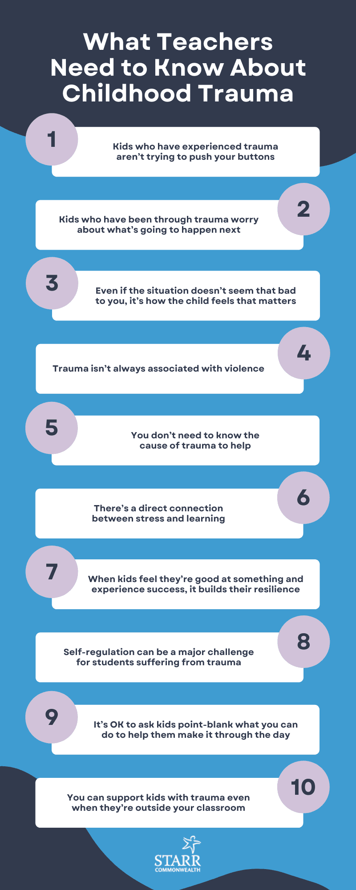
Source: Trauma Informed Teaching: 10 Things Every Educator Needs To Know (weareteachers.com)
https://www.weareteachers.com/teachers-help-childhood-trauma/

Slide 6
What does trauma-informed teaching look like? Making simple changes to class structure and interactions with students can have a huge impact on those who are experiencing trauma.
Here are strategies for educators to try:
Be mindful of your own emotions. Identifying and managing your feelings is the first step in helping students manage theirs.
Expect that students will overreact sometimes. Provide the space and time they need to calm down. Let them know this is a normal response to trauma.
Give students opportunities to talk or write about their experiences. Understanding the reasons behind a student’s behavior can help you respond with empathy.
Remind yourself that behavior is a form of communication. Try not to take it personally.
Communicate with families about what you’re seeing. They might have ideas you could try in class. Or they might ask you for ideas on how to help at home.
Make sure your teaching is culturally responsive and doesn’t exacerbate traumatic experiences students may have had.
Teach and model social and emotional skills, including positive behavior strategies.
Ask the school counselor or other mental health specialist for recommendations and support. For behavior issues, a functional behavioral assessment can help identify what is causing the behavior and how to help.
From : What is trauma-informed teaching?

Slide 7
Useful resources:
https://www.visionpsychology.com/neuroscience-of-the-impact-of-trauma-on-the-developing-brain/
https://ventana.fl.unc.edu.ar/files/movement-the-brain.pdf
https://www.iberdrola.com/talent/what-is-neuroeducation
https://www.ncbi.nlm.nih.gov/pmc/articles/PMC3181836/
https://childmind.org/article/how-trauma-affects-kids-school/
https://traumasensitiveschools.org/trauma-and-learning/the-problem-impact/
https://www.ncbi.nlm.nih.gov/pmc/articles/PMC8248342/
https://turnaroundusa.org/what-is-co-regulation-and-what-does-it-look-like-in-the-classroom/
https://www.helpguide.org/articles/ptsd-trauma/helping-children-cope-with-traumatic-stress.htm
https://www.helpguide.org/articles/stress/relaxation-techniques-for-stress-relief.htm
Activities: https://www.savethechildren.org/us/charity-stories/easy-at-home-relaxation-activities-to-help-calm-kids#:~:text=This%20is%20a%20simple%20relaxation,you%20blow%20out%20the%20candle.
Exercises: https://www.connecticutchildrens.org/coronavirus/resilience-is-mindfulness-calming-exercises-for-kids/

