Slide 1
Common reactions to stressful events among children aged 7 to 12 years are:
• Their level of physical activity changes.
• They feel and behave confused.
• They withdraw from social contact.
• They talk about the event in a repetitive manner.
• They may be reluctant to go to school.
• They feel and express fear.
• They experience a negative impact on memory, concentration and attention.
• They have sleep and appetite disturbances.
• They show aggression, irritability or restlessness.
• They have somatic complaints (physical symptoms related to emotional stress).
• They are concerned about other affected people.
• They experience self-blame and guilt feelings.”
Source: Save the Children (2013) ,Psychological First Aid Training Manual for Child Practitioners

Slide 2
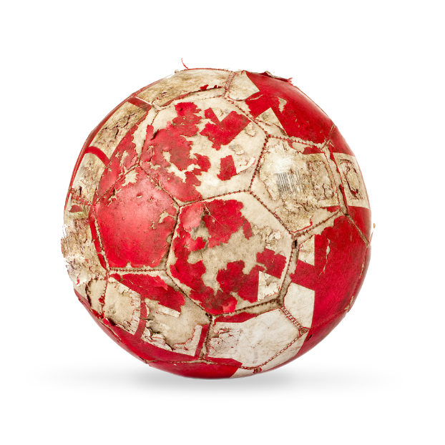
Common reactions
32
7 - 12 years
Level of physical activity changes
Feel and behave confused Withdraw from social contact
Talk about the event in a repetitive manner Are reluctant to go to school
Feel and express fear
Source: Save the Children (2013) ,Psychological First Aid Training Manual for Child Practitioners

Slide 3
Common reactions
33
7 - 12 years
Negative impact on memory, concentration and attention
Sleep and appetite disturbances Aggression, irritability, restlessness Somatic complaints (physical symptoms
related to emotional stress)
Concerned about other affected people Self-blame and guilt feelings
Source: Save the Children (2013) ,Psychological First Aid Training Manual for Child Practitioners

Slide 4
Common reactions
36
Teens
Feel intense grief
Feel self-conscious or guilt and shame that they were unable to help those who were hurt
Show excessive concern about other affected persons May become self-absorbed and feel self-pity
Changes in interpersonal relationships
Source: Save the Children (2013) ,Psychological First Aid Training Manual for Child Practitioners

Slide 5
34
Cognitive development of teens:
Transition from child to adult
Searching for own identity
Peers more important, although still attached to family Understand perspectives of others
Understand consequences on self and others Growing sense of responsibility mixed with guilt
and shame
Source: Save the Children (2013) ,Psychological First Aid Training Manual for Child Practitioners

Slide 6
During the transitional teen years, children are often preoccupied with wanting to define themselves in relation to others. While the child is still attached to the family, peers play a very important role as the child gradually gets engaged in social life.”
“Teens have a growing understanding of others’ perspectives, even if they are different to their own, and they understand the seriousness of an emergency situation from their own viewpoint as well as from others’ viewpoints.” “Teens start to feel a strong sense of responsibility for the family, and some are already family breadwinners. Guilt and shame are also common feelings during this period.”
Teenagers often feel intense grief. They feel self-consciousness or guilt and shame that they were unable to help those who were hurt, and they show excessive concern about other affected persons. They may become self-absorbed and feel selfpity, and they may experience changes in their relationships with other people.”
“Teenagers may also start taking risks, engage in self-destructive behaviour, have avoidant behaviour, and become aggressive. They experience major shifts in their view of the world, accompanied by a sense of hopelessness about the present and the future. They often become defiant of authorities and parents, while they start relying on peers for socialising.”
Source: Save the Children (2013) ,Psychological First Aid Training Manual for Child Practitioners

